Slide 1


Excel Class
Lookup formula

Slide 2

Analysing the Walmart Case Study using the Excel Functions

Slide 3
Lookup and Index Functions in Excel
Lookup and Index functions in Excel allow users to search, retrieve, and manipulate data based on specific criteria or conditions.
These functions are particularly useful for finding values, matching data, and performing dynamic data referencing.
Lookup Functions like - VLOOKUP, HLOOKUP, XLOOKUP, INDEX, MATCH, OFFSET, ROW, ROWS, COLUMN, COLUMNS, INDIRECT

Slide 4
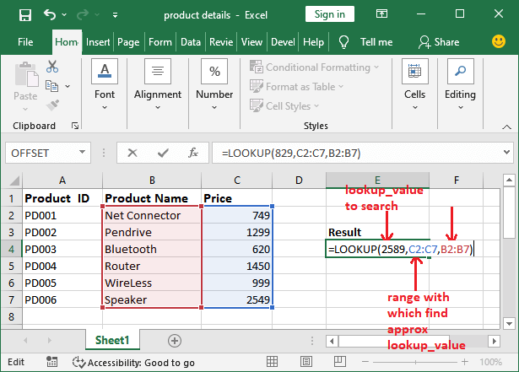

Slide 5
Insights and Analysis on Walmart dataset
Utilizing these functions on the Walmart dataset, we can gain insights and perform various use cases, such as:
Retrieving specific values based on lookup criteria (e.g., product information, sales data).
Matching and combining data from different tables or ranges.
Dynamic data referencing and manipulation based on changing conditions.
Extracting information based on row or column numbers.
Performing conditional calculations and analysis using indirect references.

Slide 6

Business Use Case
Lookup and Index functions provide powerful capabilities for data retrieval and referencing in Excel. By applying functions such as VLOOKUP, HLOOKUP, XLOOKUP, INDEX, MATCH, OFFSET, ROW, ROWS, COLUMN, COLUMNS, and INDIRECT, we can draw meaningful insights and perform various use cases on the Walmart dataset. These functions enable us to search, match, and dynamically reference data, facilitating deeper analysis and decision-making processes.

